Slide 1
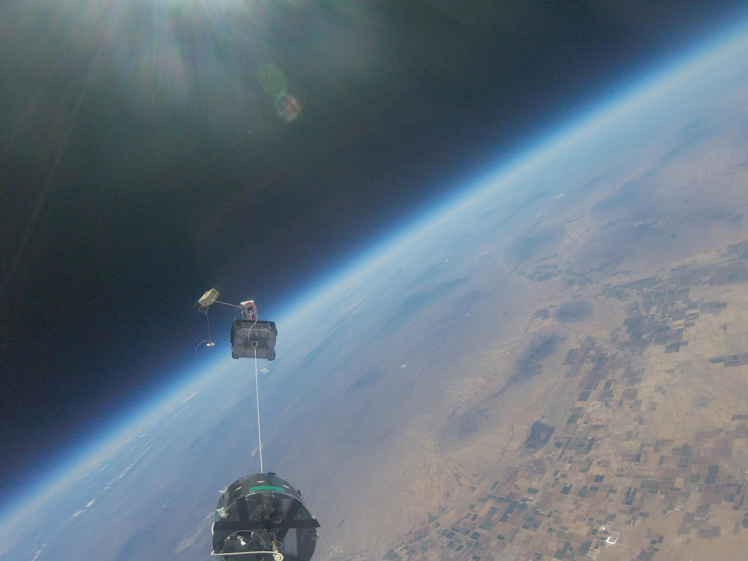
URSA MAJOR
ASCEND TEAM 2016!

Slide 2
Notes:
https://youtu.be/HxLfWlG1voI

Slide 3
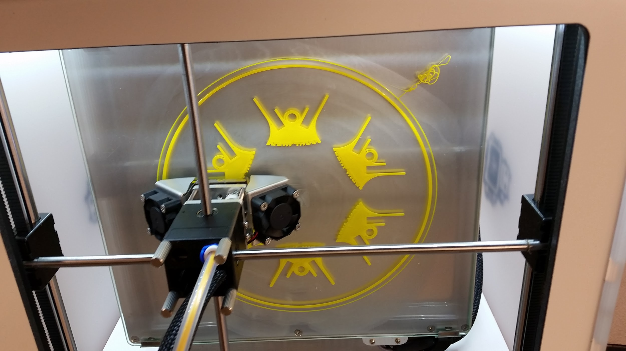
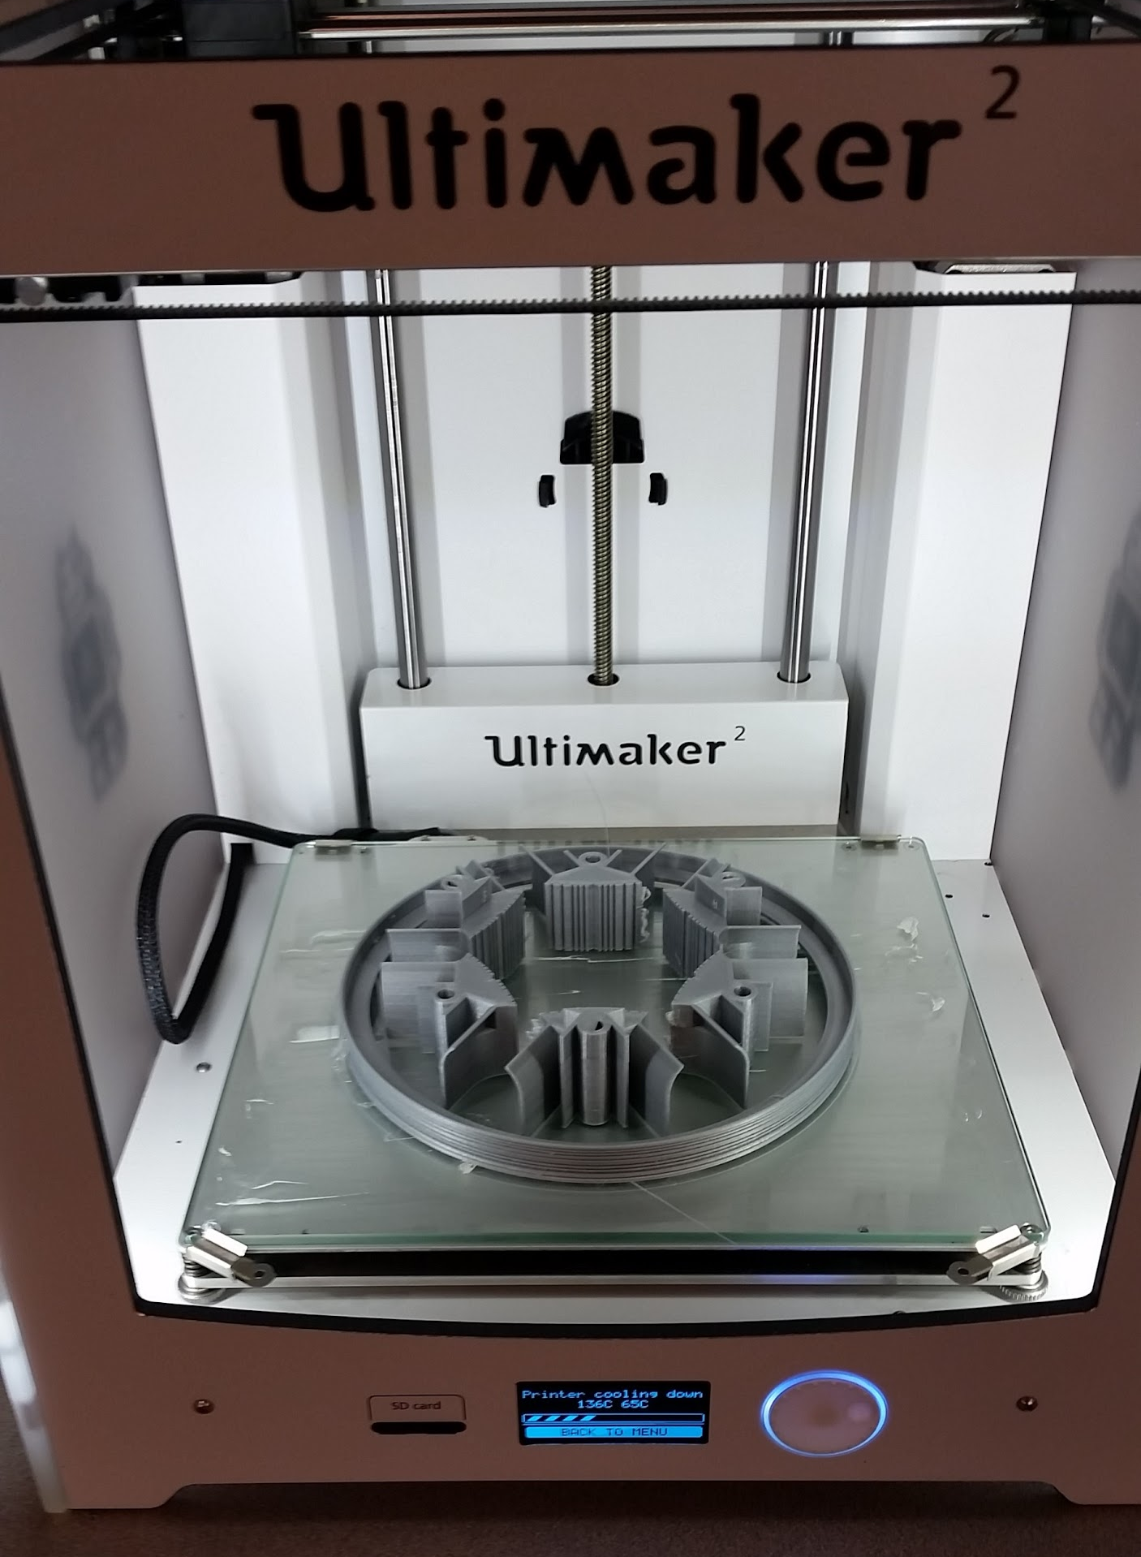
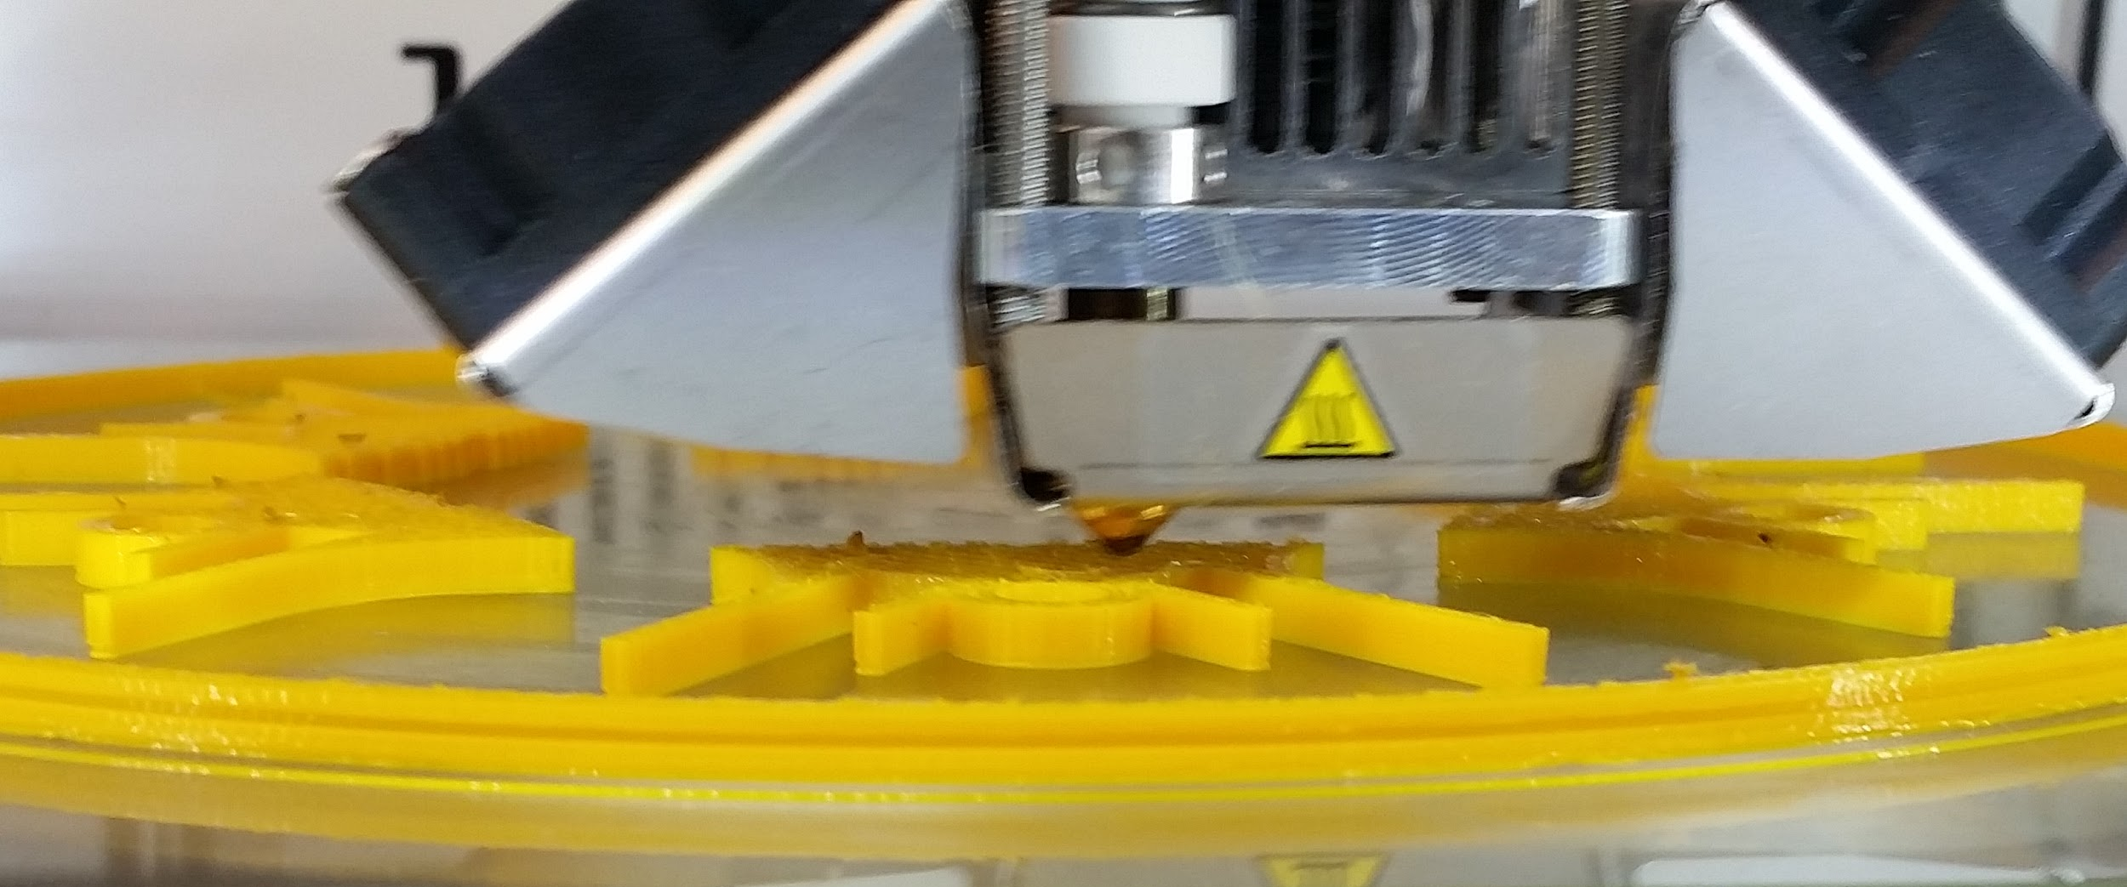
DESIGN:
3D PRINTING

Slide 4
Notes:
https://youtu.be/2RCWj5VevGM

Slide 5
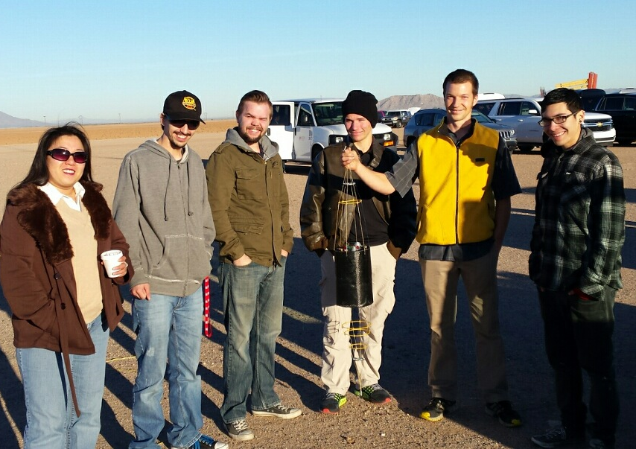
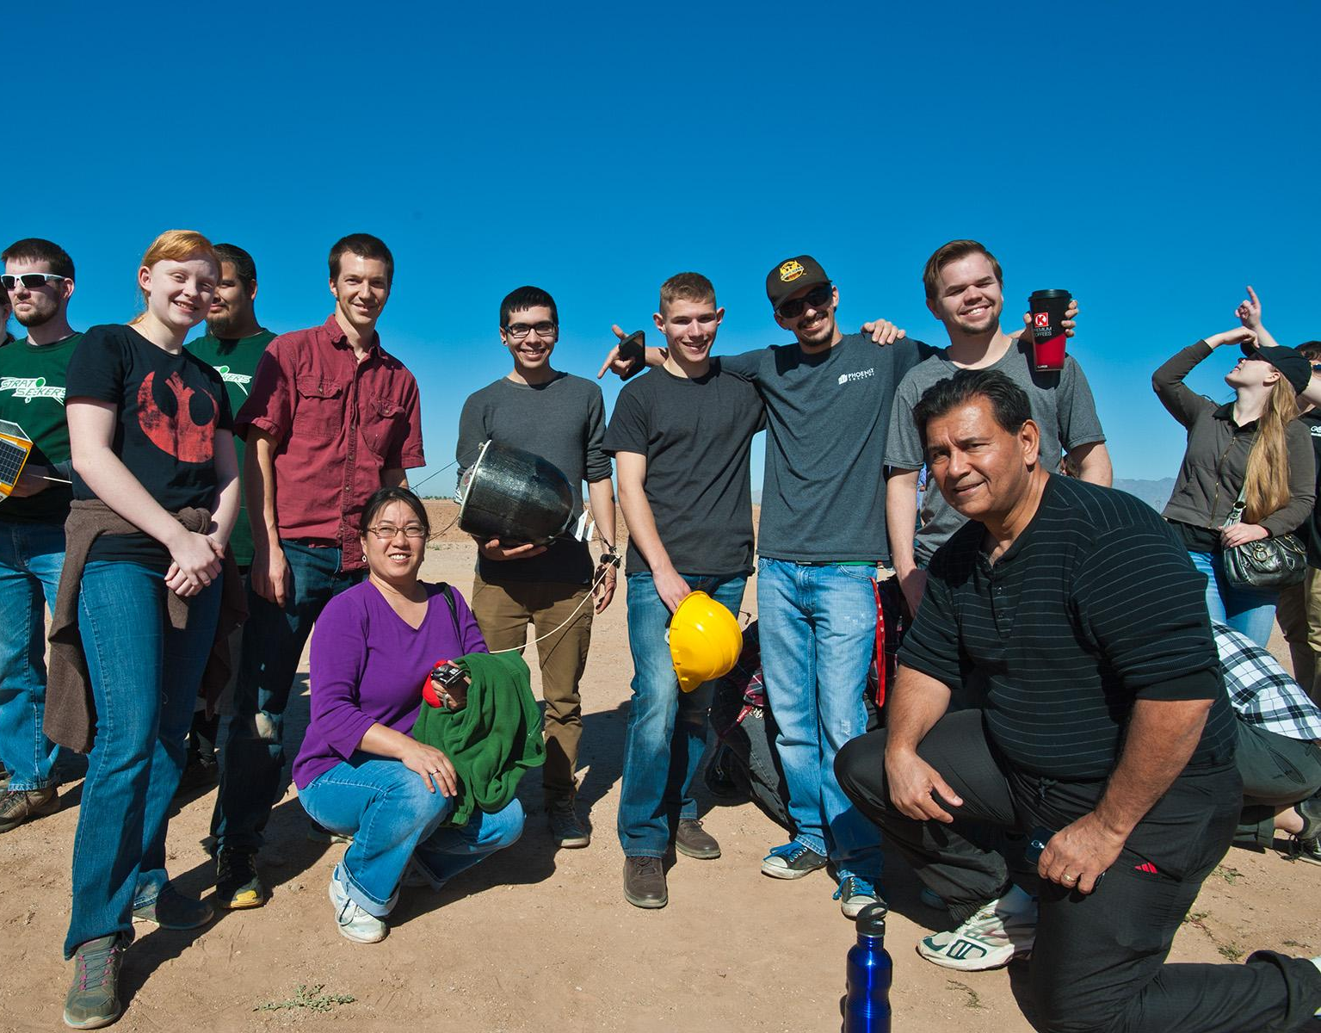
DESIGN:
PAYLOAD HOUSING
FALL 2015
SPRING 2016

